Slide 1
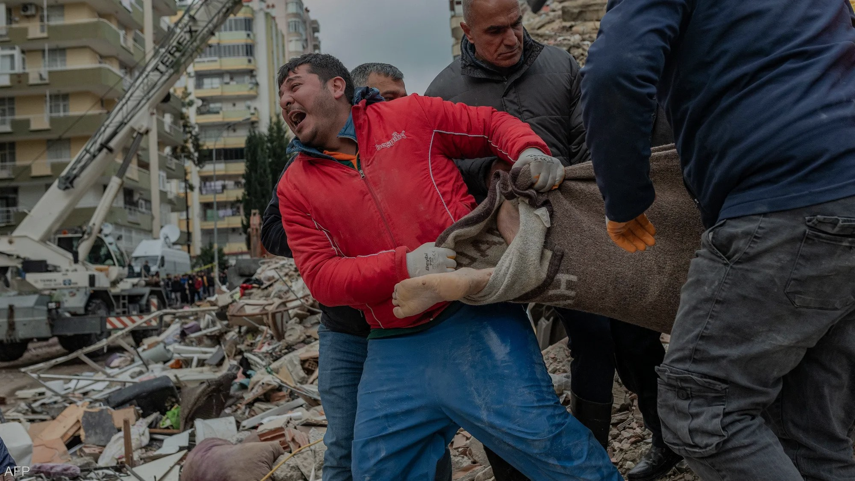
Market:
Notes:
Story Naziha:
My family and my uncle's family were too close. In fact, their house is located directly across from ours. We share every detail of our lives, our jokes, and often enjoy cooking together, then came 17th December 2016 and our life has never been the same.
My cousin was injured while defending my home country (Syria) during the war. We reached there and saw him bleeding from head to foot. We felt extremely helpless. It was a painful accident that I will never forget. It is literally stuck on my mind to this day . His life depended on the ambulance, but unfortunately, the ambulance arrived too late and we lost him.
Because of the war , my uncle's family was forced to escape to Turkey, only to face another disaster that was the 2023 earthquake. Even after he did his best efforts to find an exit, he was stuck in the home and had no choice to save himself so the disaster took his life.
I would never wish someone else to go through what I went. First losing my cousin and then my uncle. We all hold families really close to our hearts.

Slide 2

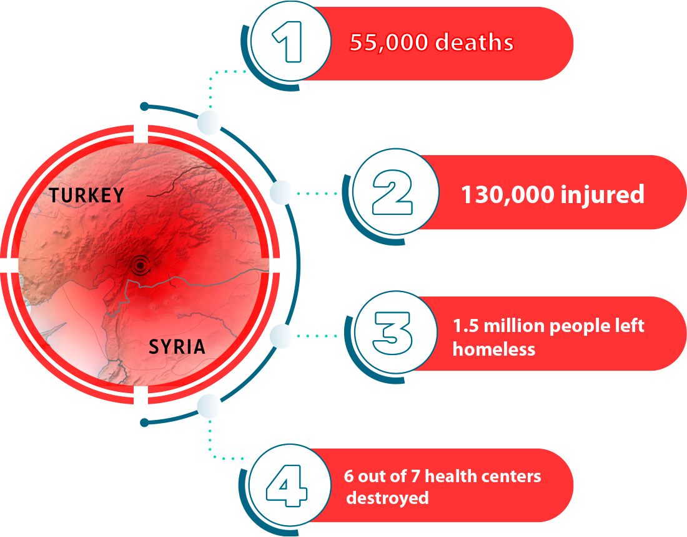
Notes:
Naziha is not the only one who suffered the loss of her loved ones. In the Turkey Earthquake of 2023 55 thousand people died, 130,000 suffered critical injuries and 1.5 million were left homeless in need of shelter and basic necessities of life. Adding to this calamity every 6 out of 7 health centers were destroyed which worsened the situation.

Slide 3
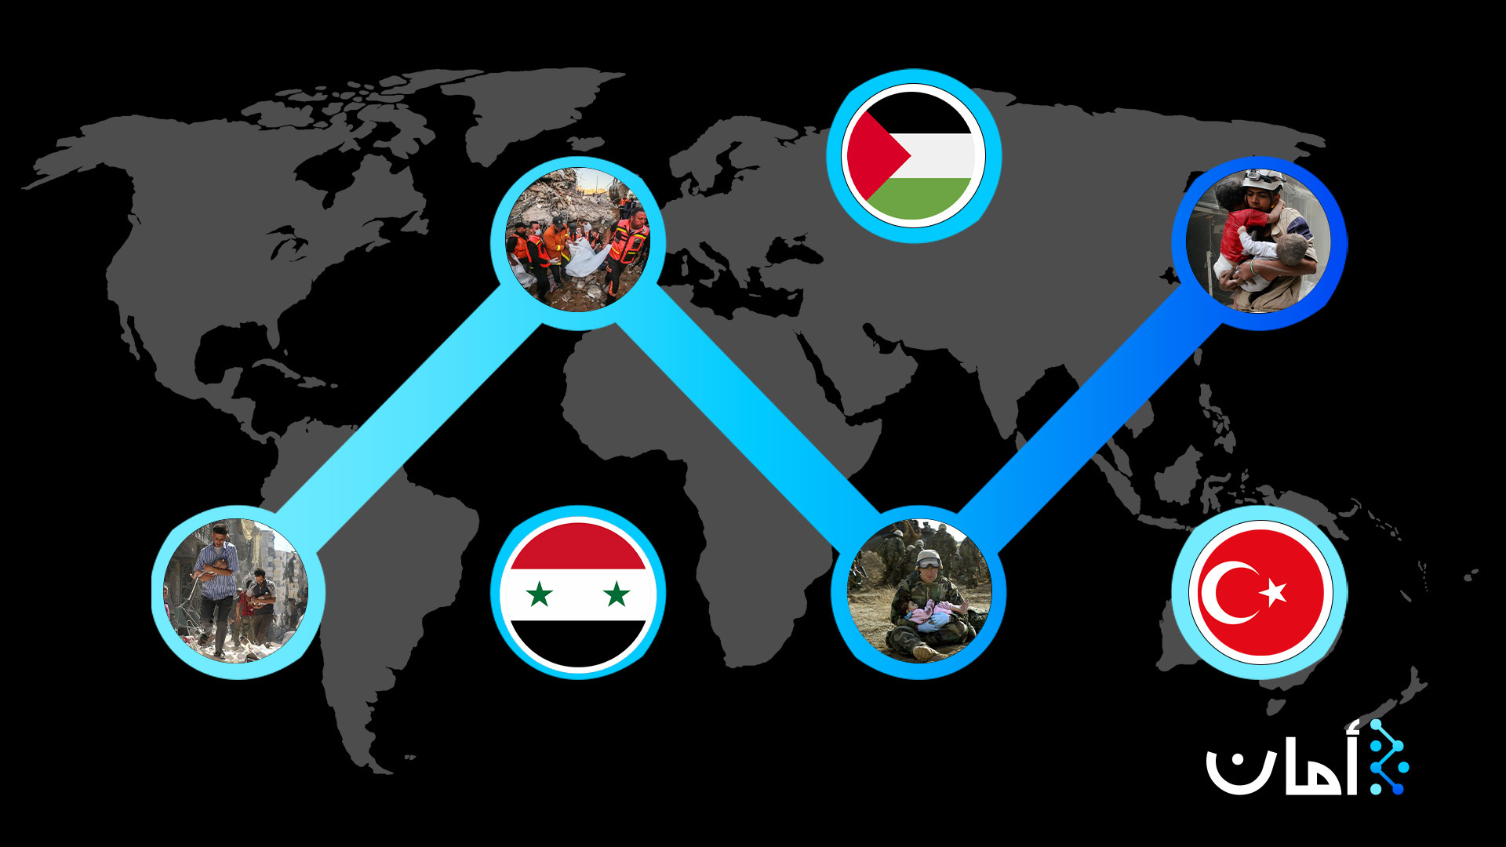
Impact
Notes:
And Turkey is not only the only place in the middle east where these kinds of disasters occurs:
The earthquakes also affected people syria
There is a war in palestine with lots of victims
And the same disasters happen in the civil war in Iraq

Slide 4
WHAT IF ?
Notes:
What if… the ambulance arrived a few minutes earlier? What if Naziha’s uncle and cousin could actually be saved?
What if we could place the new health centres just in the right location for people to reach in time?
What if we use Quantum Computing to save all these lives?
(NOTE : now we go to next slide)

Slide 5
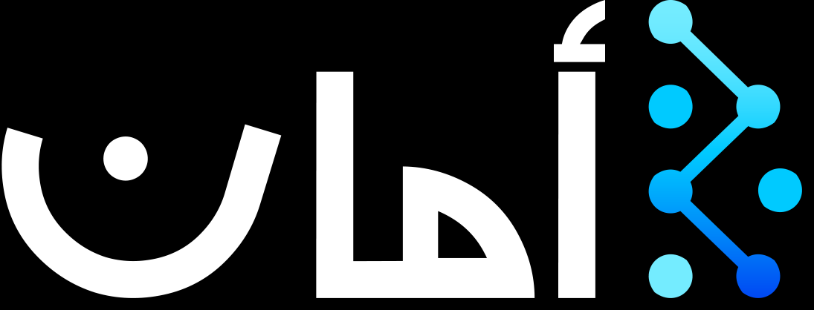
Amaan (Safety)
SDG 3: Good Health and Well-being
https://github.com/Anisen123/NYUAD-2023
Notes:
Amaan is arabic word for safety and we aim to work towards the third sustainable development goal which is good health and well being. During catastrophes and emergencies, our quantum algorithm, based on QAOA, optimizes the placement of scarce resources by minimizing the time for citizens to reach them.
(NOTE : now we go to next slide)

Slide 6
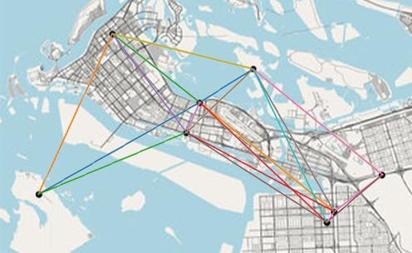
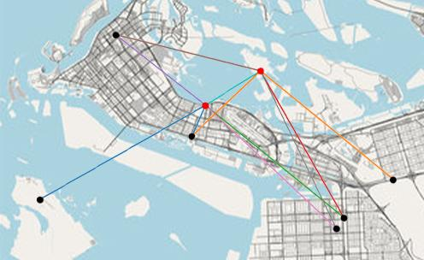
Algorithm Details
Map of potential safe zones
Short edges connecting safe zones
Problem modelled as a maximum k-vertex cover
Classically NP-hard

Slide 7
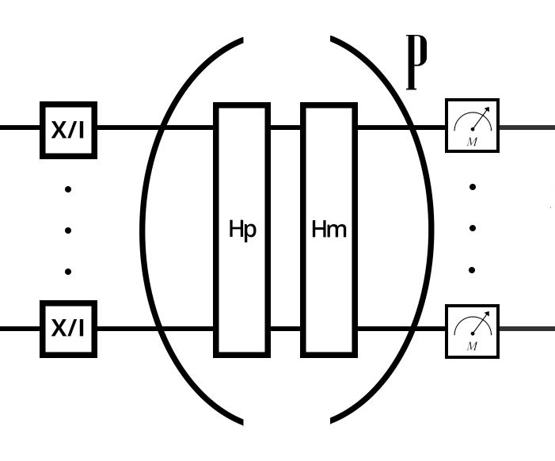
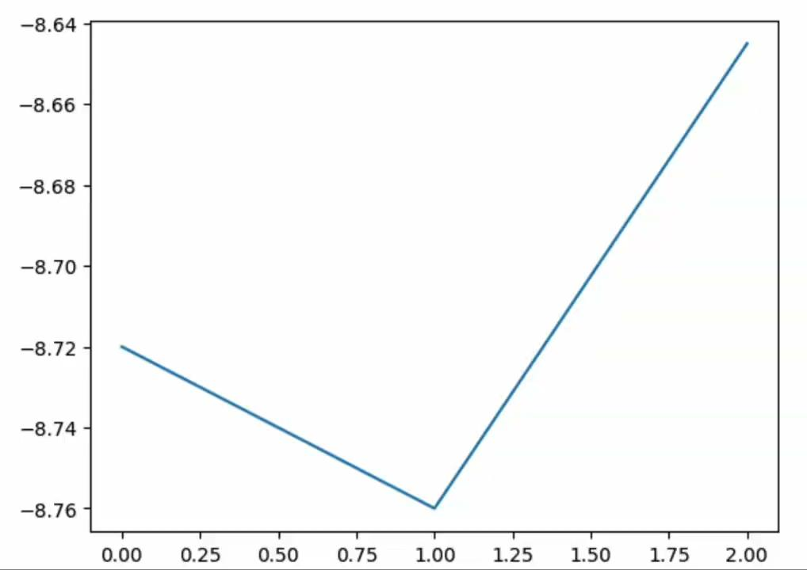
Demo
Score
QAOA algorithm (Quantum Alternating Operator Ansatz)
Score represents how many people (or vertices) are connected to safe zones, which is encoded in the problem Hamiltonian
Classical minimization algorithm minimizes the score in order to connect safe zones to the most number of people
Number of Iterations

Slide 8

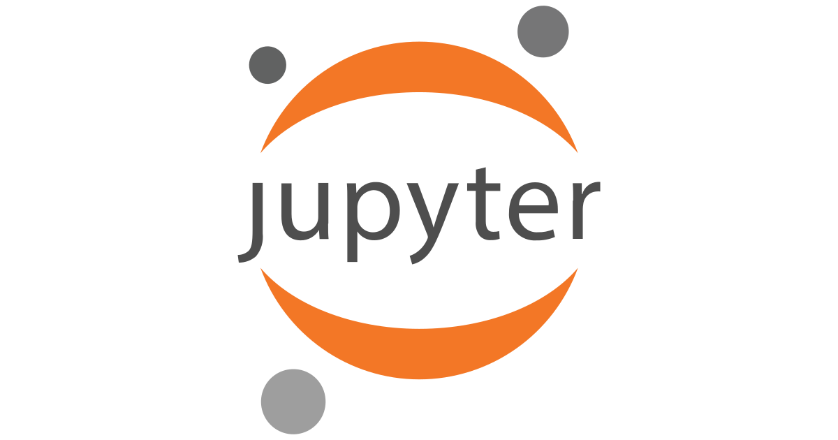
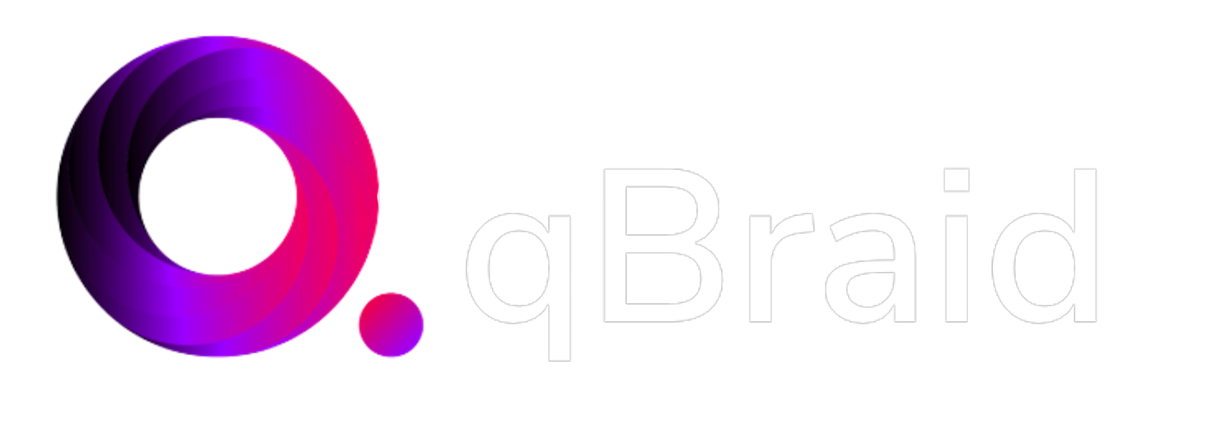

Hack Stack
Software: qBraid, Qiskit, and QAOA.
Programming languages: Jupyter notebook, python.
Notes:
We are going to be using IBM's guadalupe Quantum computer, and we’ll use qBraid platform, qiskit library and QAOA algorithm, in Jupyter Notebook
(NOTE : now we go to next slide)

Slide 9
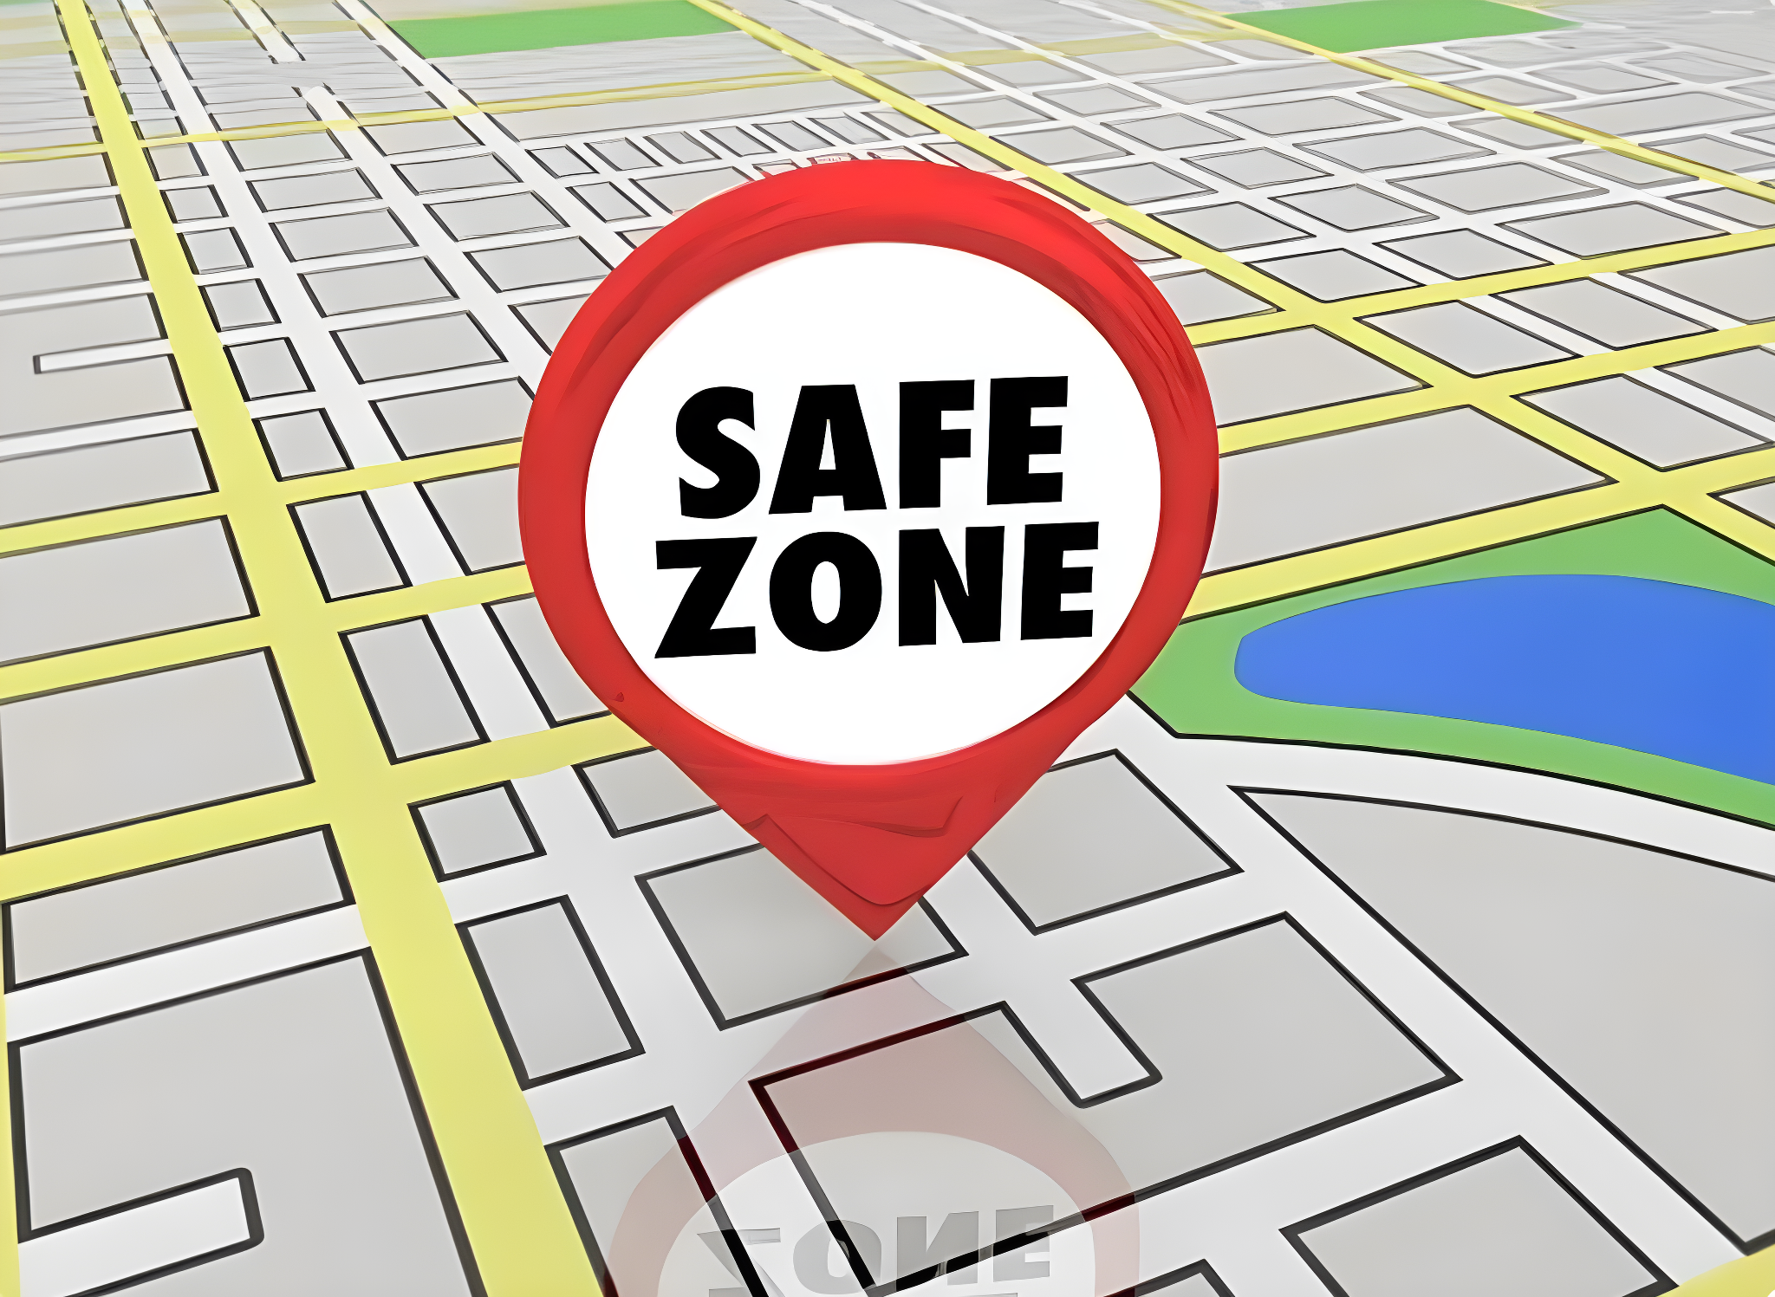
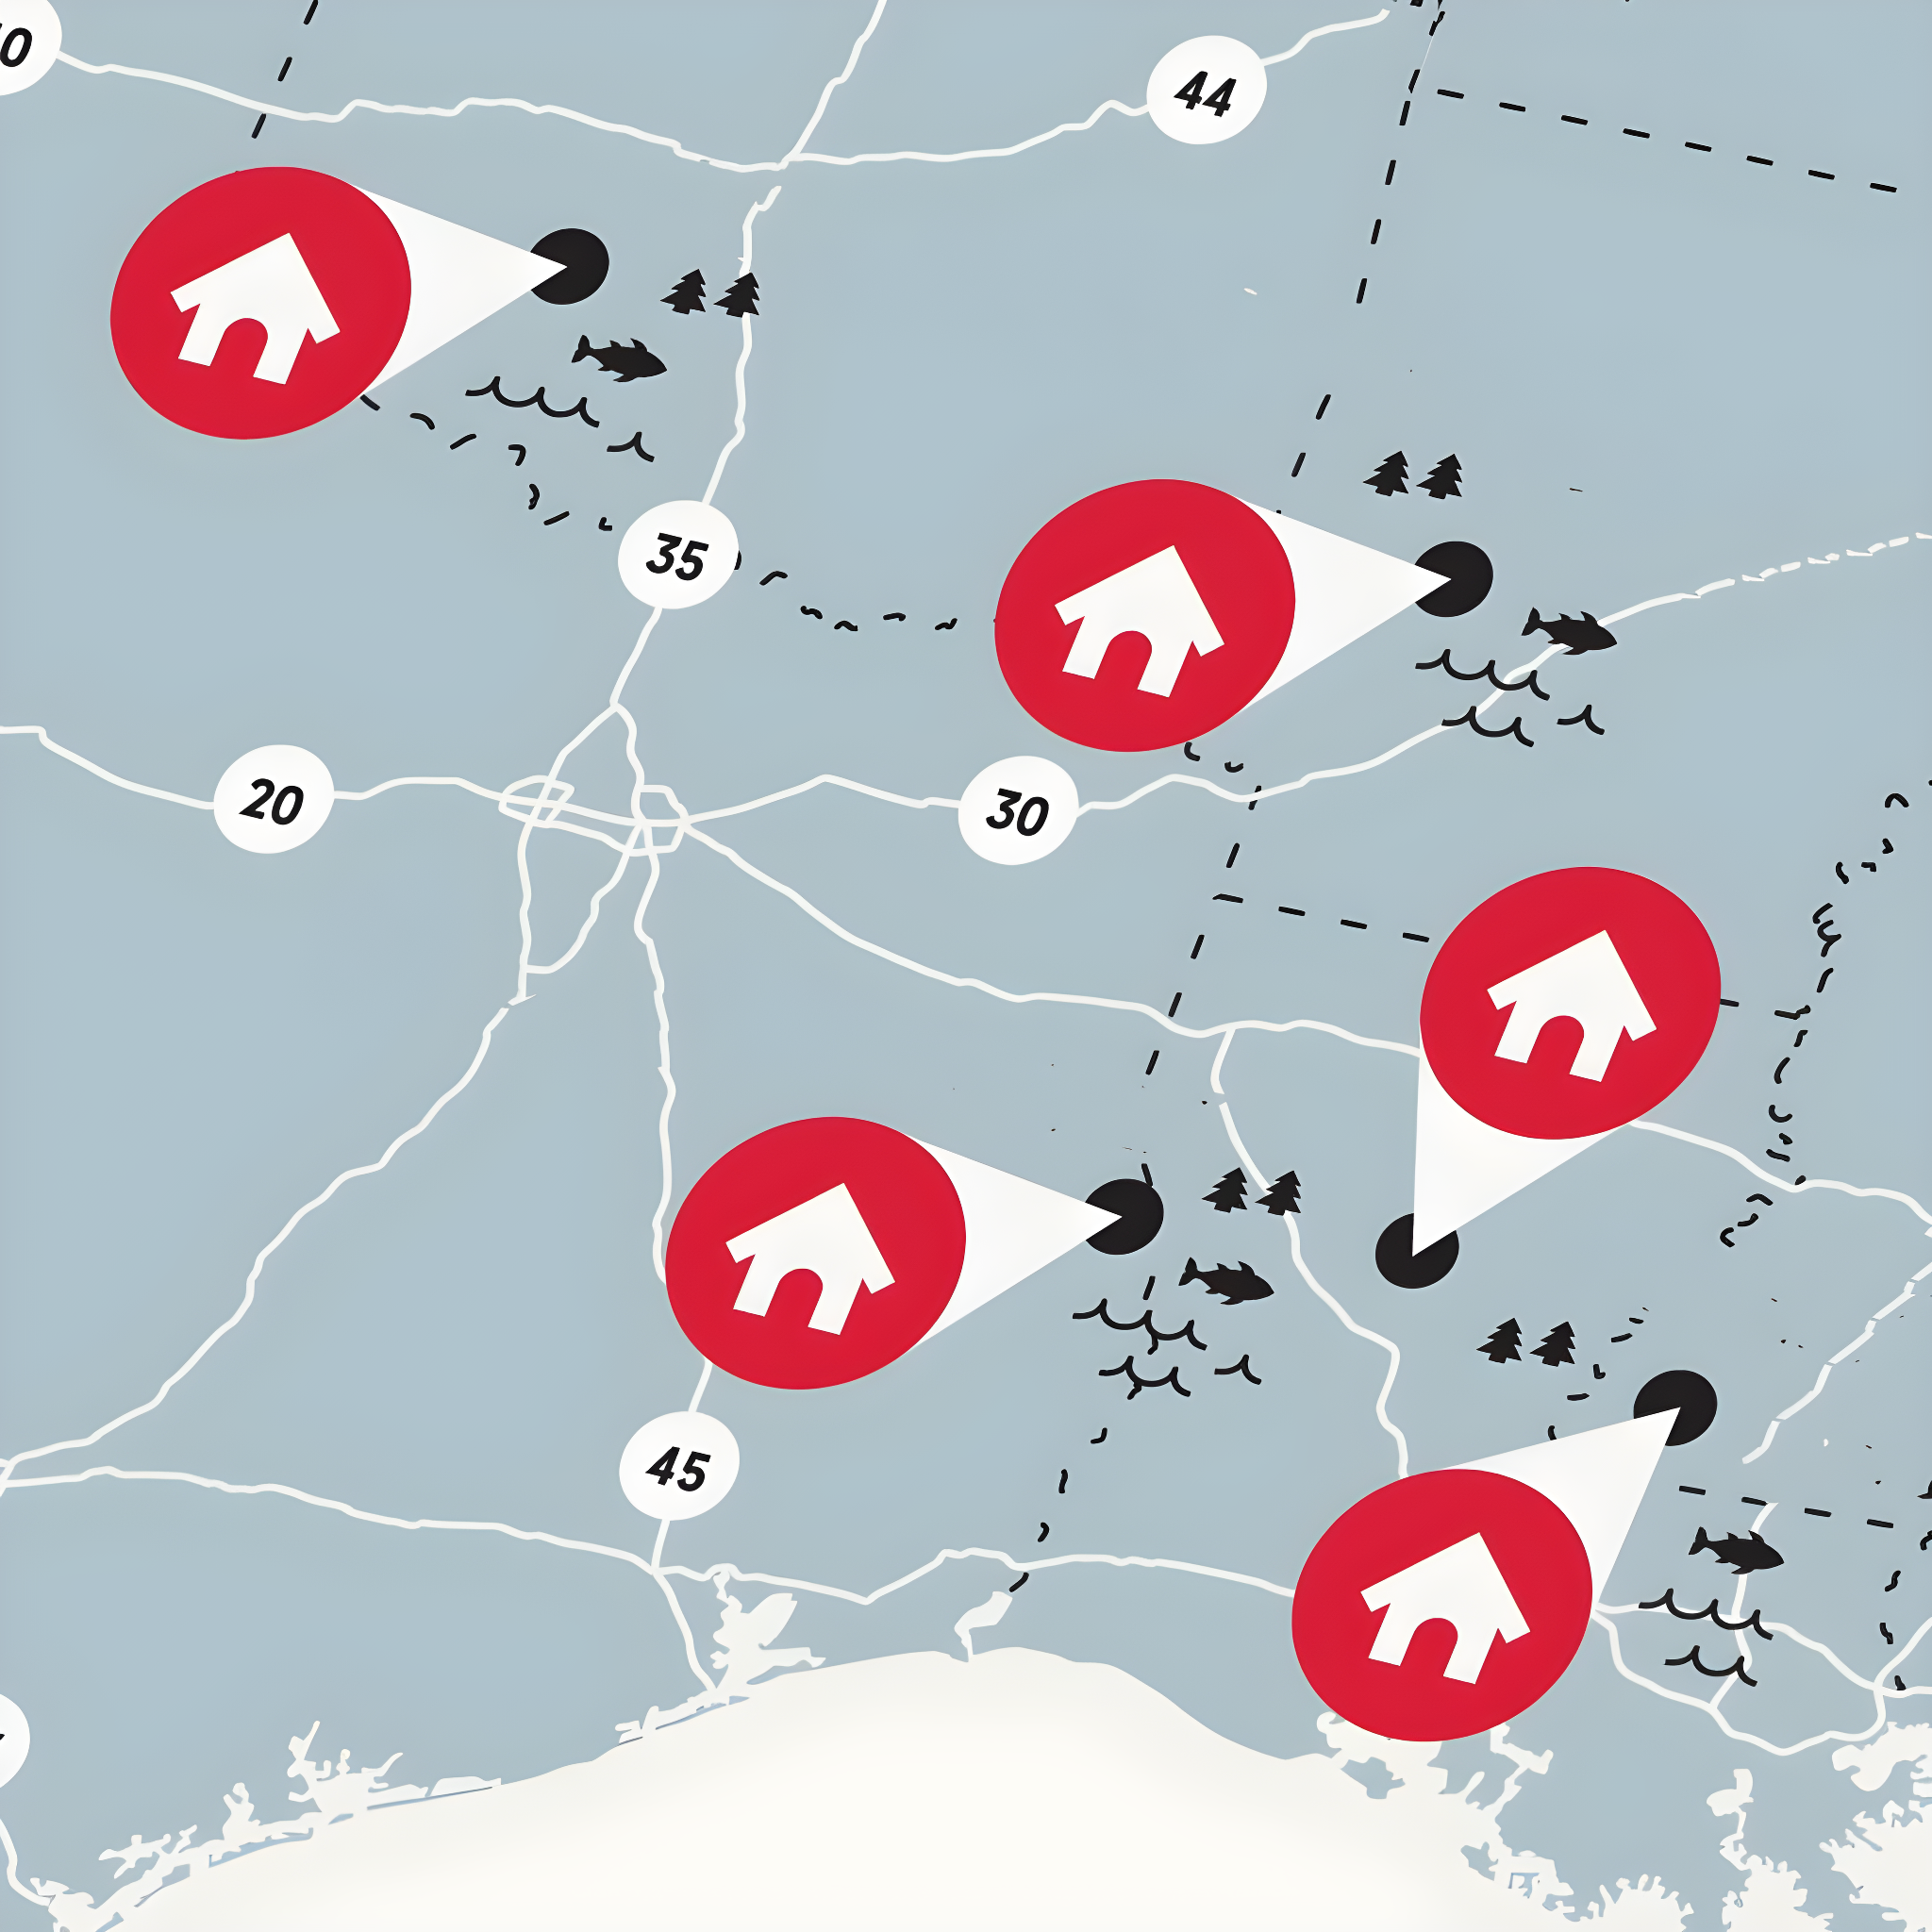

Scalability
Residence
Centers
Notes:
Now we will talk about the scalability of our solution. As we are using QAOA algorithm, we can add several safe zones and residences, we are limited only by qubits, because each qubits represent a population center.The more qubits we have the more efficiently we can save lives.
—-------------------------
QAOA is an algorithm that can be scaled really well.
As quantum computers and data available improve we’ll be able to scale that product to whole nations, continents or even the world.

Slide 10







Funding
Partners
Notes:
The future of our solution in terms of funding we will seek funding from
1. Government grants
2. Private foundations
3. United Nations
4. Public Funding
In the future we plan to partner with
NGOs
Red cross
Red Crescent

Slide 11
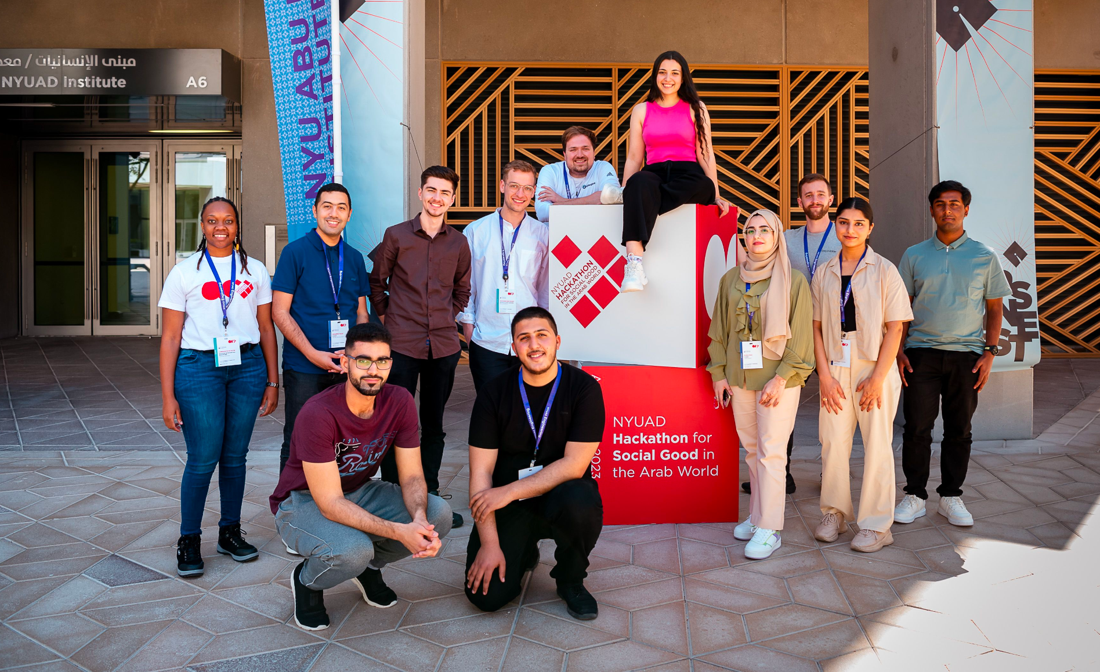

Nadjib
Abdul Rahman
Alex
Ben
Menna
Lukas
Saamia
Lorraine
Mahmood
Aniruddha
“You have a chance to save lives! If you don’t take it, you may regret it!”
-Widad Akrawi
Team 15
Huthayfa
Naziha
Notes:
We are team 15

